Slide 1

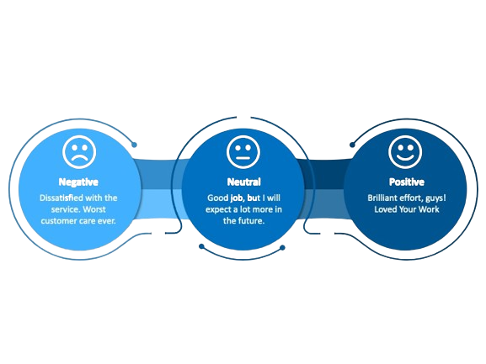
CHALAPATHI INSTITUTE OF ENGINEERING AND TECHNOLOGY(AUTONOMOUS) Chalapathi Nagar, Lam Guntur - 522034. Andhra Pradesh, India PROJECT REVIEW ON
FLIPKART REVIEWS SENTIMENT ANALYSIS
USING DEEP LEARNING
Presented by:
Guided by:
Penumuchu Grishma Sri (Y20CDS044)
Sankarasetti Sita (Y20CDS052)
Gaddam RaghuVarma (Y20CDS016)
Ganguru Venkateswararao (Y20CDS018)
V.Amani ,M.Tech
Assistant Professor
Department of Computer Science and Engineering with Data Science
April 2024
1

Slide 2
CONTENTS
Abstract
Problem Statement
Introduction
Objectives
Tools and technologies
Data collection / Data analysis
Findings and results
Applications
Conclusion & Future Scope
References
Department of Computer Science and Engineering with Data Science
April 2024
2
2

Slide 3
ABSTRACT
The "Flipkart Reviews Sentiment Analysis Using Deep Learning Python Project" involves utilizing advanced deep learning techniques to analyze sentiments expressed in customer reviews on the Flipkart e-commerce platform. This project aims to develop a model capable of classifying reviews as positive, negative, or neutral, providing valuable insights into customer satisfaction. Leveraging Python and deep learning frameworks, the project focuses on training a sentiment analysis model with a diverse dataset of Flipkart reviews. The abstract emphasizes the application of cutting-edge techniques to enhance the understanding of customer sentiments and improve the overall user experience on the platform. Reading separate evaluations takes a lot of time, so what we can do is summarize the complete review into three points. For this, we can use of Sentiment intensity analysis set of rules. It is greater inexperienced than some other set of rules like visualization or records mining.
KEYWORDS:Data Science,Sentiment analysis, opinion mining, reviews, e-commerce, natural language processing, and semantic analysis.
Department of Computer Science and Engineering with Data Science
April 2024
3

Slide 4
PROBLEM STATEMENT
E-commerce systems, consisting of Flipkart, collect a large quantity of purchaser feedback via evaluations. To gain actionable insights into purchaser sentiments, it is vital to expand a robust sentiment evaluation device. The purpose of this mission is to leverage deep studying techniques to create an accurate sentiment category model for Flipkart critiques. The device has to robotically categorize reviews as superb, negative, or impartial, enabling Flipkart to understand customer delight stages, become aware of regions for development, and decorate the overall consumer enjoyment. The assignment must address challenges associated with diverse product categories, varying review lengths, and evolving language nuances within purchaser feedback. The final result is anticipated to be an efficient and deployable solution that aids in selection-making and purchaser-centric upgrades on the Flipkart platform.
Department of Computer Science and Engineering with Data Science
April 2024
4

Slide 5
INTRODUCTION
In the dynamic landscape of e-commerce, customer feedback serves as a valuable repository of insights, offering a direct window into user sentiments.Sentiment analysis tries to uncover emotions in the text. By analyzing reviews, customer feedback, companies may discover many interesting things. So learning how to build sentiment analysis models is quite a practical skill.For the accurate classification of sentiments, many researchers have made efforts to combine deep learning and machine learning concepts in recent years. This section briefly describes the numerous studies related to sentiment analysis of web contents about users' opinions, emotions, reviews toward different matters and products using deep learning techniques.
What is Sentiment Analysis?
Sentiments are feelings, opinions, emotions, like/dislikes, good/badSentiment Analysis is a Natural Languages Processing and Information Extraction task that aims to obtain writer's feelings expressed in positive or negative comments, questions and requests, by analyzing a large numbers of documents.
Department of Computer Science and Engineering with Data Science
April 2024
5

Slide 6
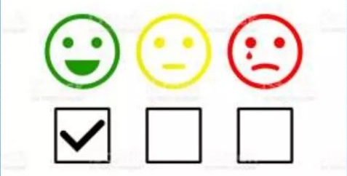
Sentiment Analysis is a study of human behavior in which we extract user opinion and emotion from plain data or text.
"Sentiment Analysis is also known as Opinion Mining".
Example
✓ User's Opinion:
Person 1: It's a good product. (Positive Statement)
Person 2: Nah! I didn't like it at all. (Negative Statement)
Person 3: The new Infinity T-shirt is awesome! (Positive statement)
✓ Polarity:
Positive
Negative
Neutral
Department of Computer Science and Engineering with Data Science
April 2024
6

Slide 7
OBJECTIVES
The objectives of the Flipkart reviews sentiment analysis using deep learning project are to develop an automated system for classifying customer sentiments (positive, negative, neutral) from Flipkart reviews. This system aims to provide actionable insights for product improvement, marketing strategies, and enhancing customer satisfaction through data-driven decision-making.
Department of Computer Science and Engineering with Data Science
April 2024
7

Slide 8

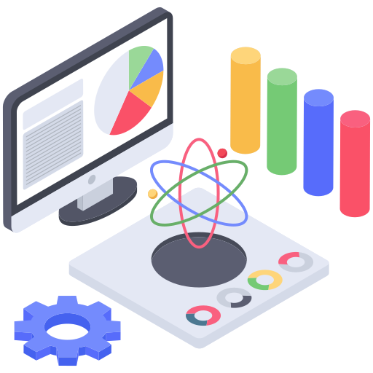
TOOLS AND TECHNOLOGIES
01
Google Colaboratory
Google Colab (Colaboratory) is a free, cloud-based platform that allows users to write and run Python code in their browser. It's an as-a-service version of Jupyter Notebook, which is an open source creation from the Jupyter Project.
TOOLS
TECHNIQUES
Packages
02
Packages like NumPy, Pandas, NLP, Scikit – learn and some Deep Learning Algorithms like XGBClassifier are used.
Department of Computer Science and Engineering with Data Science
April 2024
8

Slide 9
DATA COLLECTION / DATA ANALYSIS
05
Visualization and Interpretation
04
Model Building
&
Classification
03
1.Tokenizer
2.Stopwords removal
&
Transformation
02
Data Cleaning and Preprocessing
01
Data Collection
Department of Computer Science and Engineering with Data Science
April 2024
9

Slide 10
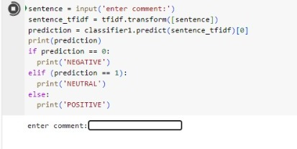
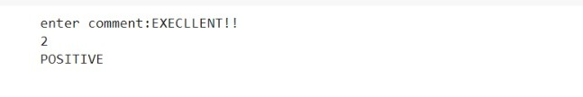

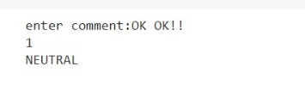
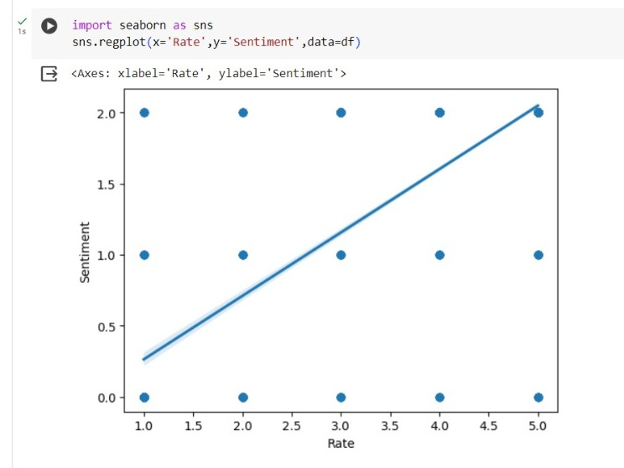
PREDICTING RESULTS
Department of Computer Science and Engineering with Data Science
April 2024
10

Slide 11
APPLICATIONS
Customer Feedback Analysis
Market Trend Analysis
Brand Reputation Management
Competitor Analysis
Social Media Monitoring
Product Analysis
Department of Computer Science and Engineering with Data Science
April 2024
11

Slide 12
CONCLUSION & FUTURE SCOPE
In conclusion, the sentiment analysis project on Flipkart reviews using deep learning techniques has provided valuable insights into customer opinions and preferences. By leveraging advanced natural language processing models, we were able to classify reviews accurately and understand the overall sentiment towards products on the platform. This analysis not only aids in gauging customer satisfaction but also offers actionable insights for businesses to improve their products and services based on user feedback. Overall, employing deep learning for sentiment analysis enhances decision-making processes and contributes to creating a more customer-centric shopping experience on Flipkart.
This algorithm is still inadequate in enhancing conversational abilities through deeper understanding of context, emotions, and user preferences, while also integrating emerging technologies like AI-driven personalization and multimodal interaction for richer user experiences. So future research will focus on solving these problems.
Department of Computer Science and Engineering with Data Science
April 2024
12

Slide 13
REFERENCES
[1]. “Sentimental Visualization: Semantic Analysis of Online Product Reviews Using Python and Tableau” Hanan Alasmari, IEEE ON BIG DATA VO., XX, NO., X, DECEMBER 2020.
[2]. “Comparative Analysis of Sentiment Orientation Using SVM and Naïve Bayes Techniques” Shweta Rana and Archana Singh, 2016 2nd International Conference on Next Generation Computing Technologies (NGCT2016)
[3]. Zied Kechaou, Mohamed Ben Ammar and Adel.M Alimi " Improving e-learning with sentiment analysis of users’ opinions "2011 IEEE Global Engineering Education Conference (EDUCON)
[4]. “Sentiment Analysis and Opinion Mining: A Survey” G.Vinodhini, RM.Chandrasekaran Volume 2, Issue 6, June 2012(ijarcsse )
[5]. “Thumbs up? Sentiment Classification using Machine Learning Techniques” Bo Pang and Lillian Lee
Department of Computer Science with Data Science
April 2024
13

Slide 14


